Slide 1
Best positioning chipset u-blox8
Multiwave
andy

Slide 2
Improved u-blox 8 engine
Type | Parameter | Ublox8 TCXO (GPS+GLO) TCXO (GPS) Crystal (GPS) |  |  | Ublox7 TCXO Crystal
Support CH |  | 72 CH (GPS, SBAS, QZSS, Glonass, Beidou, Galileo) |  |  | 56 CH (GPS, SBAS, QZSS, Glonass, Galileo)
Sensitivirty | Navigation | -167dBm | -166dBm | -161dBm | -162dBm | -161dBm
 | Reacquisition | -160dBm | -160dBm | -159dBm | -160dBm | -160dBm
 | Cold start | -148dBm | -148dBm | -147dBm | -148dBm | -147dBm
 | Hot start | -156dBm | -156dBm | -156dBm | -156dBm | -155dBm
TTFF | Hot | 1s | 1s | 1s | 1s | 1s
 | Cold | 26s | 29s | 30s | 29s | 30s
 | Aided | 2s | 2s | 3s | 5s | 5s
Update rate | Single |  | 18Hz | 18Hz | 10Hz | 10Hz
 | Concurrent | 10Hz
Position Acc. | GPS SBAS RTCM |  | 2.0m | 2.0m | 2.0m | 2.0m
 | GPS & Glonass | 2.5m
Power comsumption | Tracking (DCDC enable) | 25mA | 18mA | 17mA | 16mA | 16mA
 | Tracking (DCDC disable) | 40.6mA | 29.7mA | 29mA | 28mA | 28mA

Slide 3
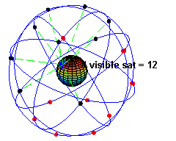
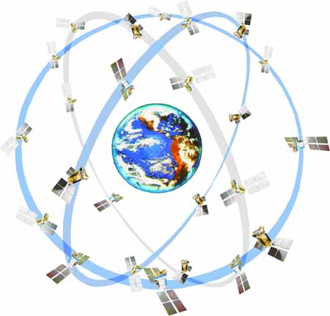
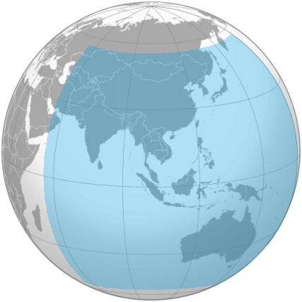
Improved TTFF by Supporting Multi GNSS
GPS | GLONASS | Beidou Phase 2
USA satellite | RUSSIA satellite | CHINA satellite
Global (Avail. SV : 30) | Global (Avail. SV : 24) | Regional (Avail. SV : 14)
CDMA | FDMA | CDMA
Accuracy : 2.0m (ublox) | Accuracy : 4m (ublox) | Accuracy : 3m (ublox)
GNSS (with TCXO)
 | GPS & Glonass | GPS & Beidou | GPS | Glonass | Beidou
Cold start | 26s | 27s | 29s | 30s | 36s
Hot start | 1s | 1s | 1s | 1s | 1s
Aided start | 2s | 3s | 2s | 7s | ** n.a
** AssistNow is not supported in Beidou
Multi GNSS mode’s TTFF is better than Single mode’s TTFF

Slide 4
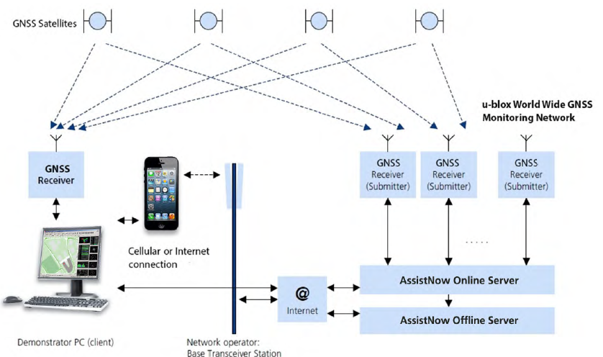
Improved AssistNow
 | AssistNow Online | AssistNow offline | AssistNow Autonomouse
ublox7 | Support GPS data | Only GPS (Max 14days) | Only GPS (Max 3days)
ublox8 | Support GPS, Glonass data | Both GPS and Glonass (Max 35days) | Both GPS and Glonass (Max 6days with SPI memory)

Slide 5
Comparison between ublox8 and ublox7

Slide 6
Navigation : u-blox M8 vs u-blox 7

